Slide 1
Modeling Pyrolysis and Combustion in Naturally Smoldering Cigarettes
AE471A Project Presentation by Krutik Desai

Slide 2
Motivation
Tobacco smoking, despite being harmful, continues to be the most common form of recreational drug use; practiced by millions around the world. With prevention difficult and widespread prevalence, it has become more critical than ever to understand the mechanisms involved in a burning cigarette and improve their construction to reduce associated risk factors.
A robust numerical simulation can:
Supply us with data not obtainable through experiments,
Aid in analysis by providing the temperature and density profiles,
Perform predictions when cigarette construction, initial densities, or dimensions are altered.
This project aims to implement a 1D model of combustion processes during smoldering, the process of slow and flameless combustion that occurs when a cigarette is set alight.

Slide 3
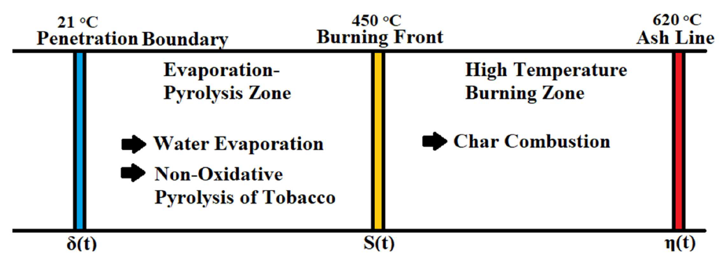
Regions and Processes

Slide 4
Regions and Processes
The boundaries of the two zones are defined at positions with a specific temperature. All three boundaries recede with time, and at steady state, their receding rate becomes constant. This rate is called the Linear Burn Rate (LBR).
The reactions that occur in the Pyrolysis Zone include the evaporation of water in the tobacco and the nonoxidative pyrolysis of virgin tobacco, which lead to the formation of residual char and volatile smoke.
In the Burning Zone, the density change is characterized by char combustion and the formation of ash.

Slide 5
Muramatsu’s Approach
A set of governing partial differential equations were written to express the heat and mass transfer phenomena in the Pyrolysis Zone.
These set of 6 simultaneous PDEs have to be solved with the Runge-Kutta-Gill Method to obtain temperature and density distributions in the Pyrolysis Zone.
When writing the governing equations, it is helpful to be in the frame of reference of the moving boundaries. Since the linear burn rate becomes constant at steady state, we can solve for temperatures and compound densities with respect to a spatial axis rather than time.
We clearly observe the decrease in total density when water evaporation starts at around 340 K. This is consistent with an increase in vapor pressure and a decrease in water density in that region.
From 450 K, a sharp decrease in total density is observed corresponding to the onset of tobacco pyrolysis into residual char—the char density increasing as a result.
The evaporation of water takes place prior to the pyrolysis of tobacco in distinct regions.
The temperature and density profiles are similar in both kinds of tobacco; however, we can observe that the reactions occur earlier spatially in the flue-cured tobacco cigarettes.

Slide 6
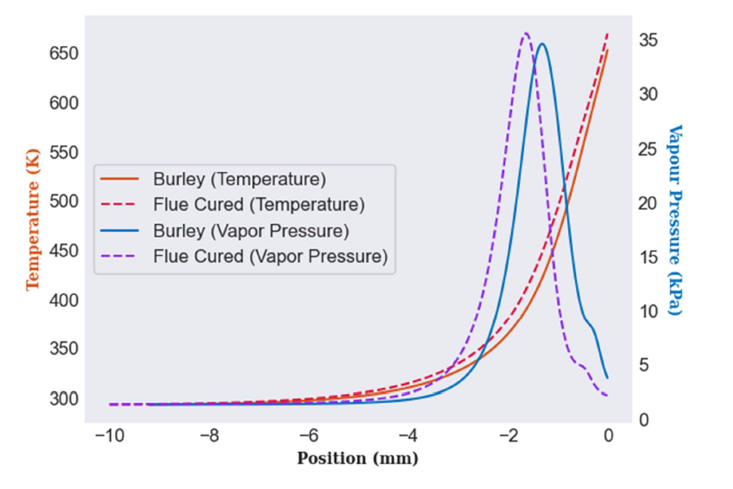
Results: Temperature and Vapor Pressure

Slide 7
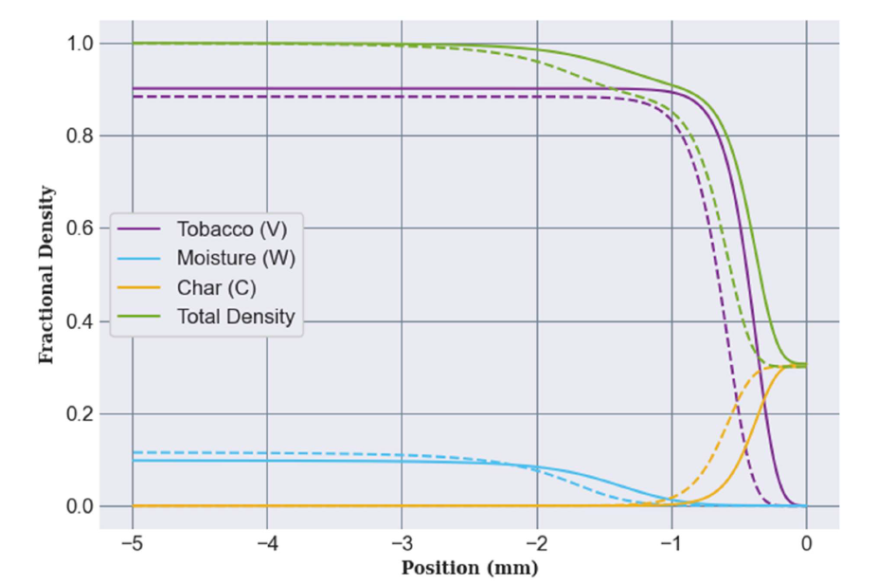
Results: Fractional Densities (Rho/RhoT0)

Slide 8
Chen’s Approach
In this model, temperatures in the pyrolysis and combustion zones were assumed to have a given functional form that satisfied the boundary conditions.
These temperature profiles were integrated across both zones to match the overall mass and energy balance constraints.
This model goes further in its analysis than Muramatsu’s approach as it outputs temperatures and densities in both zones; however, some prior knowledge about the temperature profile is required.

Slide 9
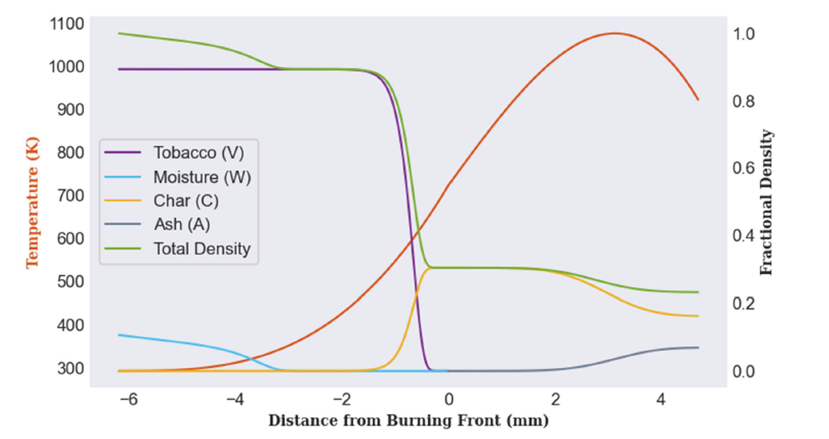
Results: Chen’s Approach

Slide 10
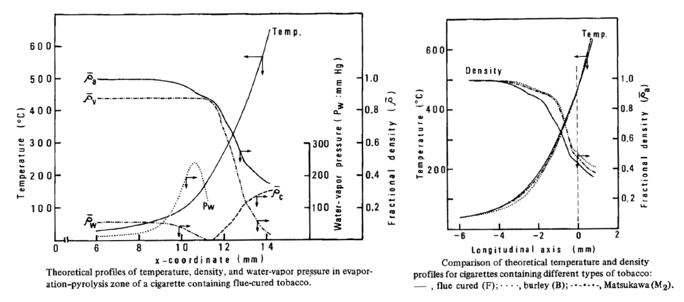
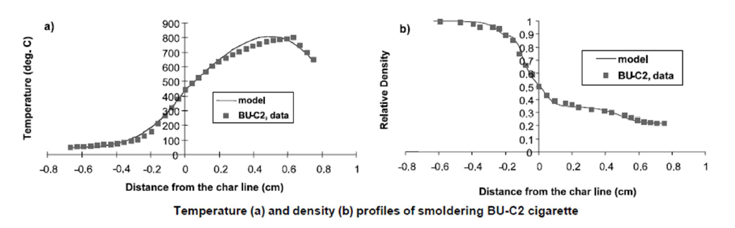
Validation

Slide 11
Thank You

